Slide 1
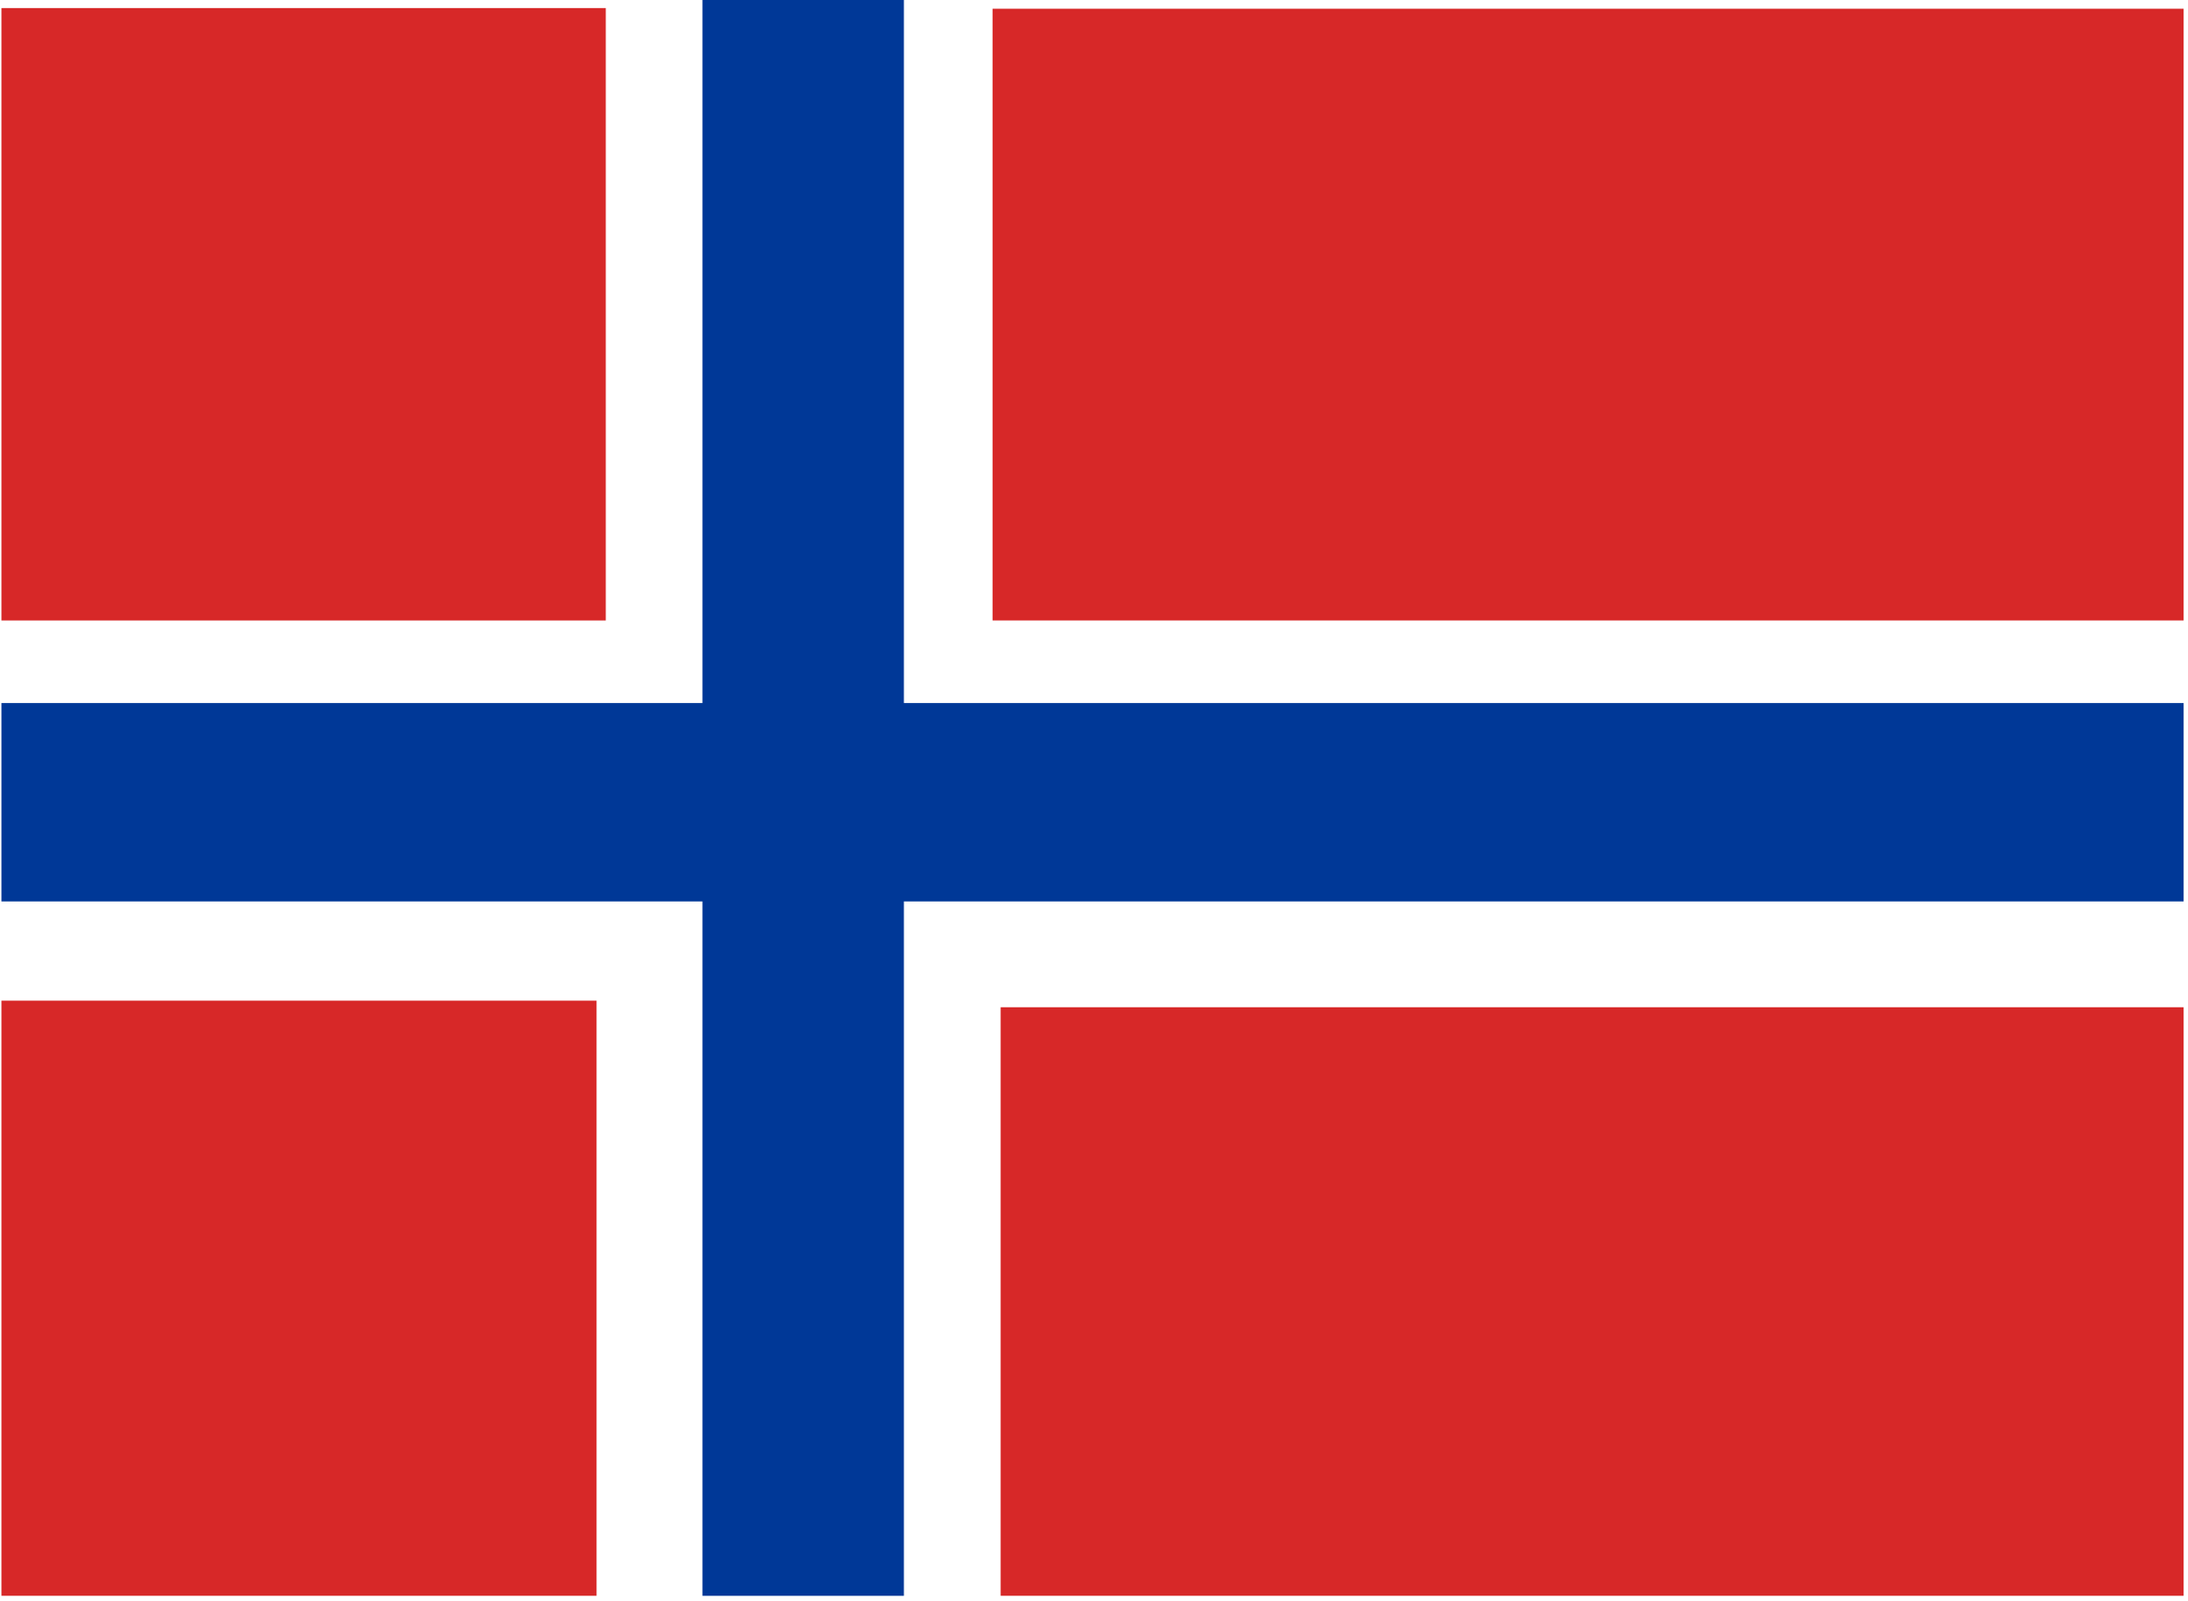
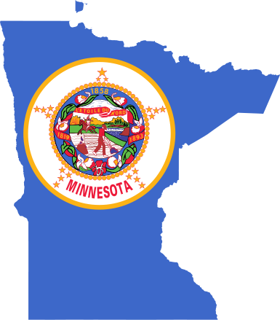
Knutson Family
Journey from Sogndal, Sogn og Fjordane, Norway to Albert Lea, Minnesota
KNUDSEN Name Meaning and History
Danish, Norwegian, and German: patronymic from a personal name derived from Old Norse Knútr meaning ‘knot’ (Danish Knud, Norwegian Knut, German Knuth). This was a Danish royal name, Latinized as Canutus.

Slide 2
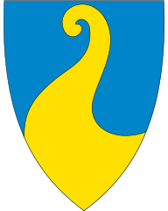

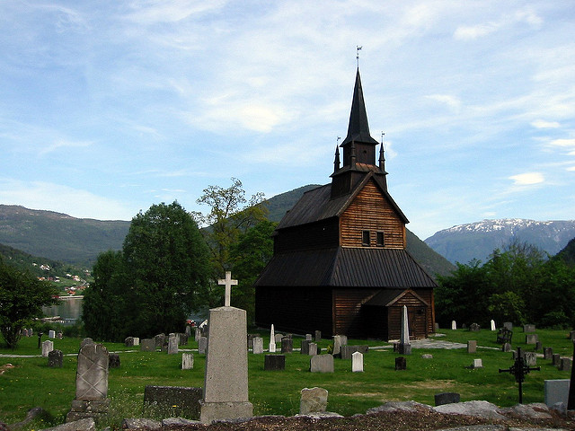

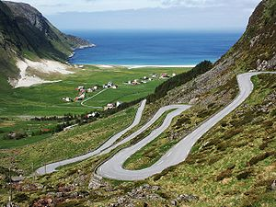
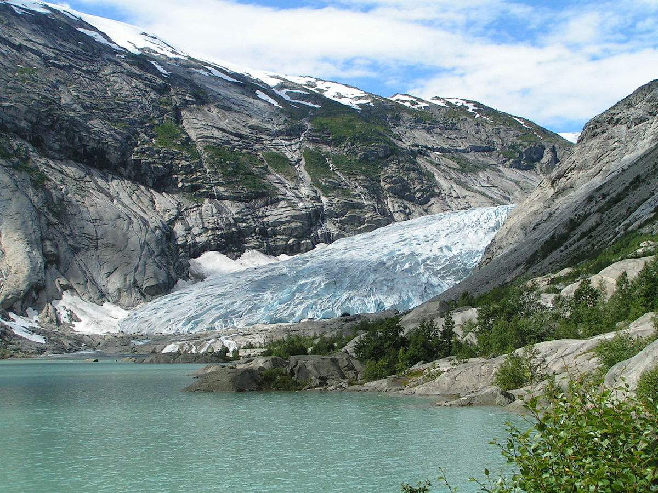
My Great Grandfather Knutson
Sylvester Elvehiem Knutson, also known as Selfest Knutson
Born 16 August 1854 – Sogndal, Sogn og Fjordane, Norway
Immigration to the US in 1875

Slide 3
Sogn og Fjordane (help·info) is a county in Norway, bordering Møre og Romsdal, Oppland, Buskerud, and Hordaland. It is mainly a rural area with a scattered population. Sogn og Fjordane includes the largest glacier in mainland Norway, Jostedalsbreen, in the Breheimen mountain range, and the deepest lake, Hornindalsvatnet. There are also many famous waterfalls located in the area. Ramnefjellsfossen (previously called Utigardfossen) is the tallest in Norway and third tallest in the world and Vettisfossen is one of Norway's highest waterfalls (with a vertical drop of 275 meters). Both are located in the Jotunheim mountains. Cruise ships visit Sogn og Fjordane all summer because of the unique vistas of high mountains and deep blue fjords.

Slide 4
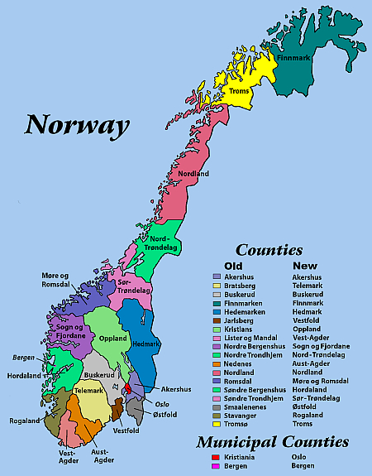

Slide 5
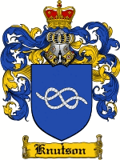
Beverly Mae Knutson
Born 11-3-1927
Albert Lea, Freeborn, MN, USA
Died 1-13-1998
Stockton, CA, USA
Spouse – Norman Stephen Brazel
Sylvester Elvehiem Knutson
Born 8-16-1854
Sogndal, Sogn og Fjordane, Norway
Died 12-20-1918
Albert Lea, Freeborn, MN USA
Spouse – Christina Knutsdtr Stime
Norman Stephen Brazel, Jr
Born 11-22-1945
Hawthorne, NV, USA
Albert Johan Knutson
Born 1-8-1905
Northwood, Worth, IA, USA
Died 6-2-1985
Stockton, CA, USA
Spouse – Bessy Lucille Marlette
Knut Johannesen Elvehjem
Born 7-10-1814
Hafslo, Sogn og Fjordane, Norway
Spouse – Susanne Ingebrigtsdatter

Slide 6
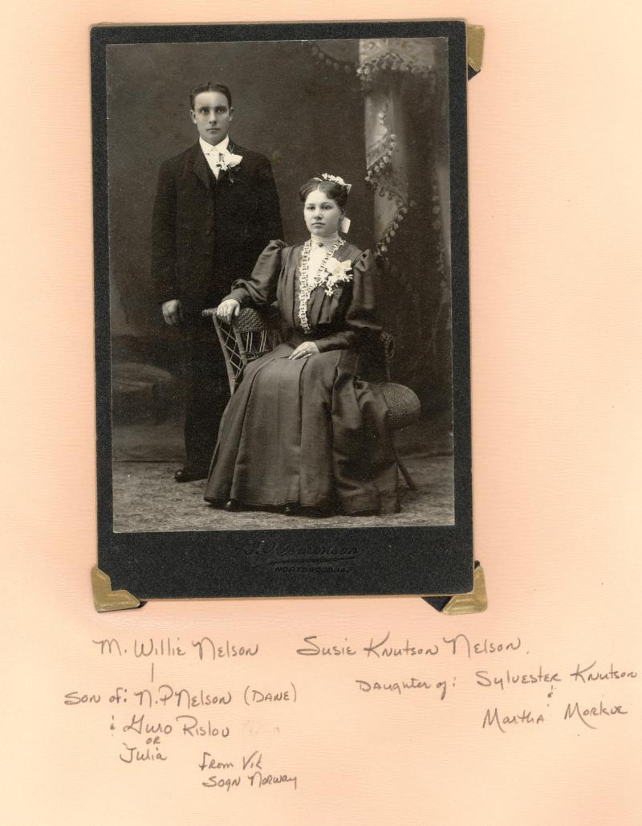
This is half-sister of my Grandfather Albert Johan Knutson.
Mother was 2nd wife of Sylvester Elvehiem Knutson, Martha Nilsdatter Morkve

Slide 7
Sources used to establish existence of individual:
Iowa, County Marriages, 1838-1934
Minnesota Deaths and Burials, 1835-1990
Iowa, Delayed Birth Records, 1850-1939
US Census 1900
US Census, 1910
Iowa State Census, 1905
Minnesota Death Index, 1908-2002
Sylvester Knutson – Individual or family possessions: birth: June 1855, Norway
Norway Baptisms, 1634-1927

Slide 8
Contents
[hide]
1National Archives
  1.1Digitalarkivet (The Digital Archives)
2Regional/Municipal Archives
  2.1For Østfold, Akershus, and Oslo counties (Fylker)
  2.2For Buskerud, Vestfold, and Telemark Counties (Fylker)
  2.3For Oppland and Hedemark counties (Fylker)
  2.4For Aust-Agder and Vest-Agder counties (Fylker)
  2.5For Rogaland County (Fylke)
  2.6For Hordaland, Bergen, and Sogn og Fjordane counties (Fylker)
  2.7For Møre og Romsdal, Sør-Trøndelag, Nord-Trøndelag, and Nordland counties (fylker)
  2.8For Troms and Finnmark counties (Fylker)
  2.9Samisk Arkiv /Sámi Arkiiva (The Sámi Archives)
3Church Parish Offices
4University and Public Libraries
5Historical and Genealogical Societies
6Other Archives and Libraries
  6.1Archives in the United States
  6.2Inventories, Registers, Catalogs
  6.3Websites

Slide 9
For Hordaland, Bergen, and Sogn og Fjordane counties (Fylker)[edit | edit source]
Statsarkivet i Bergen (State Archive in Bergen)
Address: Årstadveien 22, 5009 Bergen, Norway
Phone: 47 55 96 58 00
Fax: 47 55 96 58 01
Statsarkivet i Bergen
E-mail: sabergen@arkivverket.no
Fylkesarkivet i Sogn & Fjordane (County Archive in Sogn & Fjordane)
Address: Askedalen 2, 6863 Leikanger, Norway
Phone: +47 57 63 80 00
Fylkesarkivet i Sogn & Fjordane
E-mail: postmottak.sffarkiv@sfj.no
Hordaland Fylkeskommune arkiv (County Municipal Archive in Hordaland)
Address: Agnes Mowinckels gate 5, 5008 Bergen Norway
Phone: +47 55 23 90 00
Hordaland Fylkeskommune arkiv
IKA Interkommunalt arkiv i Hordaland (Inter-municipal archive in Hordaland)
Address: Kalfarveien 82, 5022 Bergen, Norway
Phone: +47 55 30 60 90
Interkommunalt arkiv i Hordaland
E-mail: post@ikah.no
Bergen Byarkiv (Bergen City Archive)
Address: Kalfarveien 82, 5022 Bergen, Norway
Phone: +47 55 56 62 83
Bergen Byarkiv
E-mail: post.byarkivet@bergen.kommune.no

Slide 10
Archives in the United States[edit | edit source]
The archives of the Evangelical Lutheran Church in America (ELCA) have microfilm copies of most of the Norwegian-American Lutheran church records. The copies can be loaned via the mail for a nominal fee. The ELCA is divided into nine regions. The regional archives may have additional information. Go to Evangelical Lutheran Church in America for more information.
The ELCA Archives is located at:
321 Bonnie Lane
Elk Grove Village, IL 60007
Phone: 1-847-690-9410 E-mail: archives@elca.org
Other records of Norwegians in America are kept by the United States National Archives and Records Administration. These include service and pension, naturalization, immigration, homestead records and others created by the federal government. For information, write to:
The National Archives of the United States
Washington, D.C. 20408
http://www.archives.gov/

Slide 11
Historical Societies in Norway and United States
[edit | edit source]
Norwegian historical societies can be valuable sources of information. Similar societies exist in countries where Norwegian emigrants settled. These societies often collect information about Norwegian immigrants. Some may have information about specific Norwegian individuals. Many societies have special books and manuscript collections for Norway that may be difficult to find in libraries and archives. (See the reference to bygdelags above) Other historical societies that may be of interest include:
Sons of Norway, International Headquarters
1455 West lake Street
Minneapolis, MN 55408
Phone: 612-827-3611
Internet: http://www.sofn.com
Norway Office:
(Sons of Norway)
Bernt Balchen Lodge 8-003
President: Jostein Handegard
Havreveien 57A
4635 Kristiansand
Norway
Phone: 47-38-04-43-59
E-Mail: gunnar.jostein.handegard@akerkvaerner.no

Slide 12
Knutson is a Scandinavian Last Name derived from a Patronymic
Knutsson, Knudsen are last names showing that you have Scandinavian ancestry, and that you in your paternal line have someone called Knut! Knud or Knut is a common first (given) name in the three Scandinavian countries. The name Knutson (with variants) has only been in use as last name since around 1850, thus not being suitable for Y-DNA surname research. Scandinavians with last name Knutsson are not related or descendants from the same family, instead it means that they had an ancestor whose given name was Knut, and that the family started to use the patronymic Knudsen or Knutsson as a new hereditary last name, sometime around 1800-1900 or on emigration to America.
People with patronymic last names from Denmark, Norway or Sweden should join the geographical projects for the area.
If country of origin is known, please join one of these projects - and note that the project admins will assist in adding you to the most relevant ones:
Norway DNA project
Sweden DNA project
Denmark DNA project
Danish Demes DNA project

Slide 13
A patronymic name (pater=father, latin) is a name constructed from the father’s given name. In Norse custom patronyms and matronyms were formed by using the ending -son (later -søn and -sen in Danish and Norwegian) to indicate “son of”, and -dóttir (Icelandic -dóttir, Swedish and Norwegian -dotter, Danish and Norwegian -datter) for “daughter of”. This name was used as a descriptive name for most Scandinavians. Sometimes also a third name based on location or personal characteristic was added to differentiate people.The patronymic system gradually disappeared and was replaced with a last name system in all three Scandinavian countries:
Denmark during 1828-1904
Sweden around 1900
Norway in 1923
Families would then adopt a name, either a patronymic in recent use, a farm name (Norway) or place name from the family history, a soldier name (Sweden) or other to be their hereditary last name.

Slide 14

City/State
Albert Lea, MN
Lodge
Normanna
1-052
Meetings
Freeborn County Historical Museum
1031 Bridge Avenue
Albert Lea, MN 56007
2nd Wednesday. 7:00 pm
City/State
Atlanta, GA
Lodge
Norskevenner
3-678
Meetings
Barrington Hall
535 Barrington Dr
Roswell, GA 30075
3rd Sat, 5:00 pm - 7:00 pm

Slide 15
Facebook groups:
Norweigian-American Genealogical Association
Minnesota Norwegians - Genealogy
Sons of Norway – Rosswell, Georgia, NorskeVenner Lodge 3-678
Sons of Loki Vikings
Norwegian Genealogy

